Slide 1
Notes:
Imagine you are on your daily commute and you decided to take the tricycle under a scorching sun. While you are along the way, the tricycle driver
suddenly entered a heated road rage and sped up the vehicle, which compromised your safety.
Some of you would say you’d let it pass or report it to the LTO. but is it really that simple? Is the driver even linked to the tricycle you rode?

Slide 2
IMAGINE.
Notes:
Imagine you are on your daily commute and you decided to take the tricycle under a scorching sun. While you are along the way, the tricycle driver
suddenly entered a heated road rage and sped up the vehicle, which compromised your safety.
Some of you would say you’d let it pass or report it to the LTO. but is it really that simple? Is the driver even linked to the tricycle you rode?

Slide 3
TRICYCLE PROFILER
Idel Lawrence Aranilla
BSIT - INF214
Mr. Elizer Ponio Jr.
Control Data Structure (CCDATRCL)

Slide 4
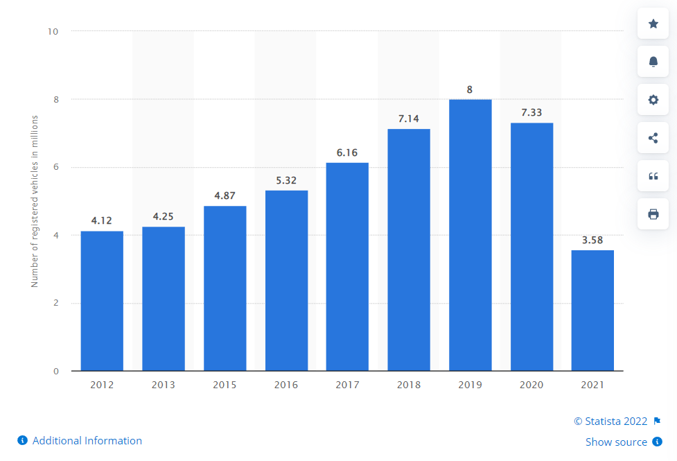
Tricycles are essential components of the public transportation in the Philippines.
There is 3.58 million registered private tricycles in 2021 alone (Statista, 2022).
Each barangay in the country has one or more TODA
(Poe, 2018).
Notes:
(3)
-or Tricycle Operators and Drivers' Association, which, as defined by Senator Grace Poe in her explanatory note for the act providing a Magna Carta for tricycle operators and drivers, is the organization of tricycle operators and drivers in a given local government unit. (Senate S. 1751).
-Explain tricycle TODAs in my Bungad and Veterans.
-Every legally registered tricycle is recognized with its three-integer body number that identifies to which operator it belongs to. The number varies
depending on the number of tricycles are in the Toda.
-In Veterans Village Toda in Project 7, for example, we have 300 total registered tricycles. Which means that from 001, the last tricycle that was registred has the number 300.
-In Bungad, we have a total of 40 registered tricycles. So you know that the last one has a body number 040.

Slide 5
Operator Driver
A tricycle operator is the one who is legally registered in TRU and LTO as the owner of the tricycle/s.
They often hire drivers to use their tricycles for their daily living in exchange of a financial return—boundary.
The one who drives the tricycle on schedule and gives due boundary to his tricycle operator.
Not registered in TRU and LTO
A tricycle operator may also be the driver as they see fit.
Notes:
Let’s define some of the words before proceeding.

Slide 6
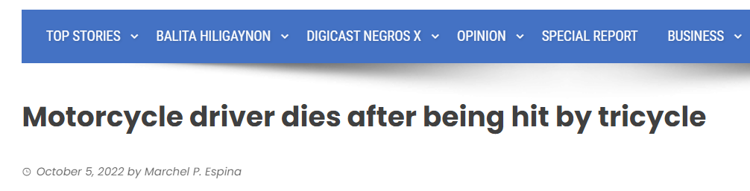
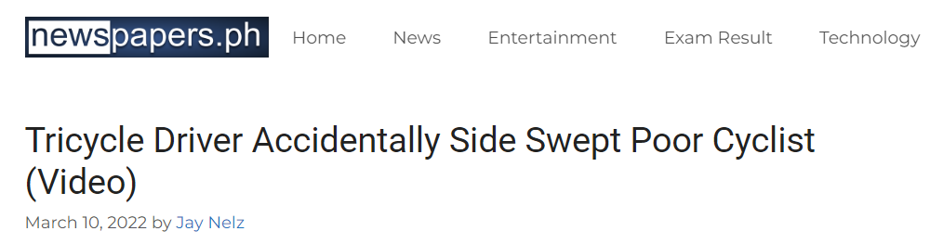
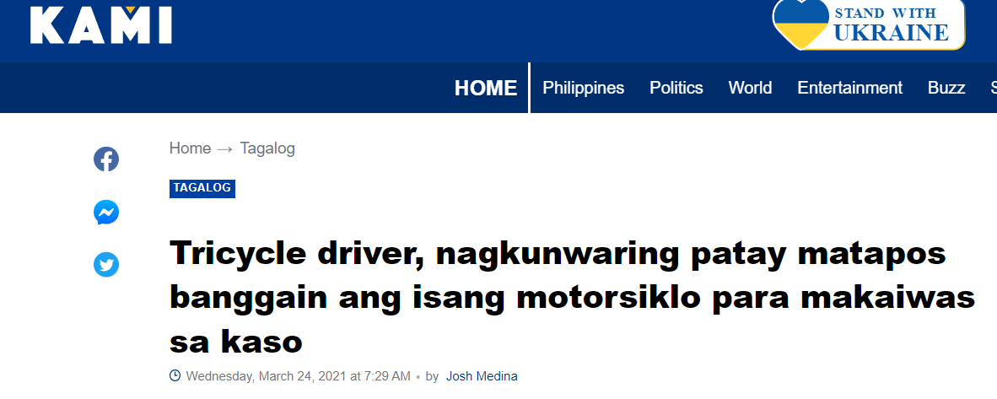

Tricycle-related accidents happen at high rates in everyday life.
Notes:
-A Motorcycle driver dies after being hit by tricycle (October 05, 2022) - Marchel Espina, Digicast Negros.
-A Tricycle Driver Accidentally Side Swept Poor Cyclist (March 10, 2022) -Jay Nelz, Newspaper.ph
-A tricycle driver who played dead after his speeding vehicle hit a motorcycle (Mach 24, 2021) - Josh Medina, Kami News.
-Accordnig to John, a foreigner, in a letter to “Live in the Philippines.com,””tricycle drivers keep charging us “foreigner price. 50% or even 100% more than usual price for Filipinos” (October 02, 2015) - Bob Martin.

Slide 7
Problem
Accidents are directed to the operator and not the driver.
An inefficient accident response is present as the driver identification become sluggish.
Notes:
(2)
Explain the process in TRU for complain reports

Slide 8
Tricycle Profiler
A terminal-based system for profiling the employed driver with their respective tricycle body number using HashMap Control Data Structure (in-beta).
Each barangay and their TODAs are registered in which the Local Government Unit (LGU) may profile the active drivers on the field.
The admin, an LGU employee, may view or delete the active drivers directory and register or remove a driver and his assigned tricycle body number.
The user, the tricycle passenger, may use the tricycle body number to identify the driver’s name for possible legal mishaps.

Slide 9
HashMap HashTable
No method is synchronized.
Multiple threads can operate simultaneously and hence hashmap’s object is not thread-safe.
Threads are not required to wait and hence relatively performance is high.
Null is allowed for both key and value.
It is non-legacy.
Every method is synchronized.
At a time only one thread is allowed to operate the Hashtable’s object. Hence it is thread-safe.
It increases the waiting time of the thread and hence performance is low.
Null is not allowed for both key and value. Otherwise, we will get a null pointer exception.
It is a legacy
(GeeksForGeeks, 2022)
Notes:
(0)
HashMap and Hashtable store key and value pairs in a hash table. When using a them, we specify an object that is used as a key and the value that you want to be linked to that key. The key is then hashed, and the resulting hash code is used as the index at which the value is stored within the table.
-Perfect for the profiling system intended to link the tricycle body number, acting as the key, with the tricycle driver, acting as the value.
(2)
A thread is a small set of instructions designed to be scheduled and executed by the CPU independently of the parent process. For example, a program may have an open thread waiting for a specific event to occur or running a separate job, allowing the main program to perform other tasks.
(3)
Since HashMap is not synchronized, therefore it's faster and uses less memory than Hashtable. Generally, unsynchronized objects are faster than synchronized ones in a single threaded application.
(4)
Tricycle body numbers with no drivers (passive registration, awaiting for new driver from the operator)
(5)
A legacy system is outdated computing software and/or hardware that is still in use. The system still meets the needs it was originally designed for, but doesn't allow for growth.
As such:
According to Josh Brown in Stack Overflow (2022), Since synchronization is not an issue, HashMap is recommended. If synchronization becomes an issue, instead of using hashtable, look at ConcurrentHashMap.
Additionally, in my program, printing the driver directory, the list of active drivers and their tricycle body numbers in an ordered list.
-HashMap allows such via its subclass called Linked HashMap.
-allows predictable iteration order (which is insertion order by default),

Slide 10
THE PROGRAM.

Slide 11
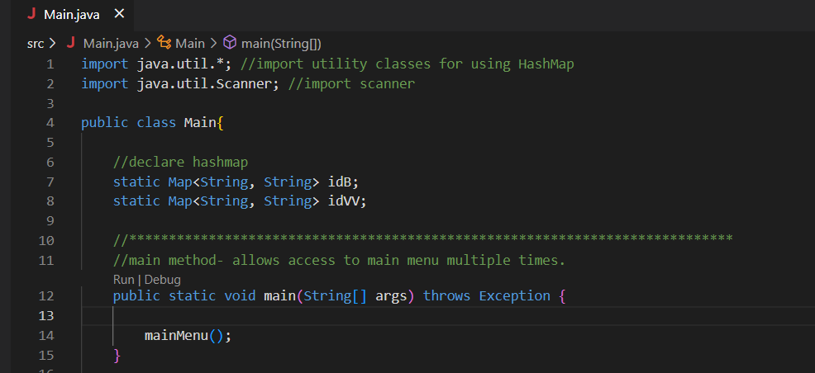
The Main Method

Slide 12
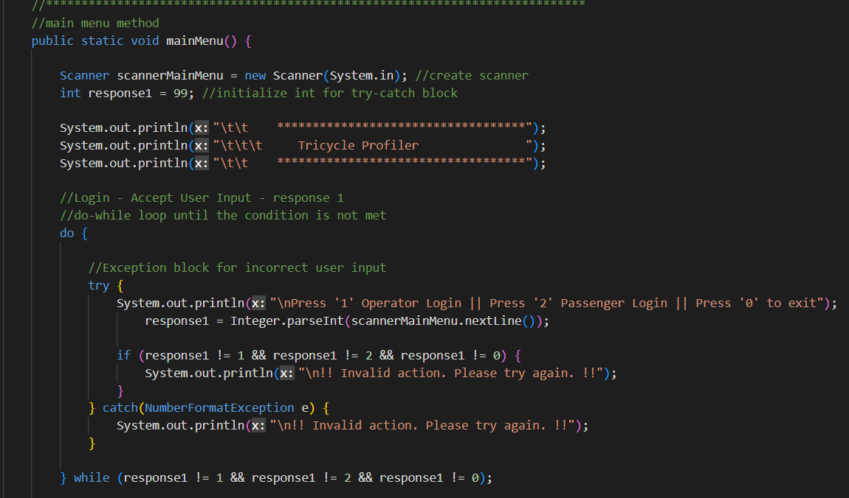
The Main Menu (1/2)

Slide 13
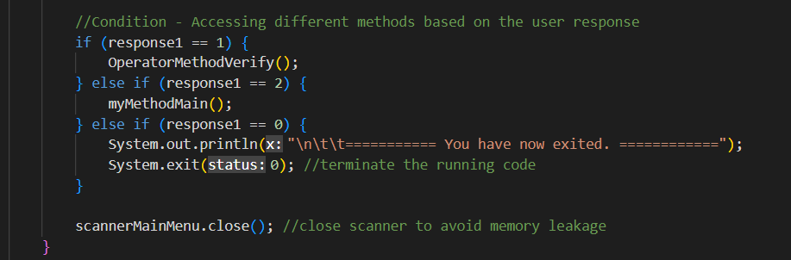
The Main Menu (2/2)

Slide 14
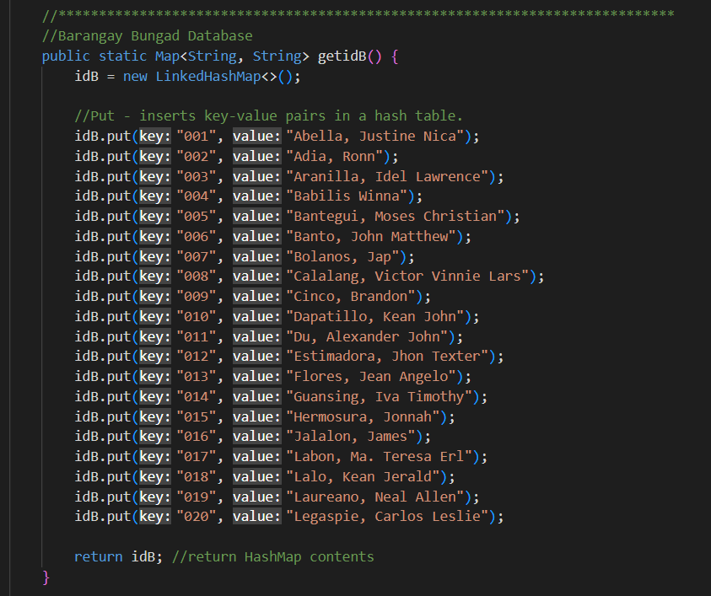
The Map
Method

Slide 15
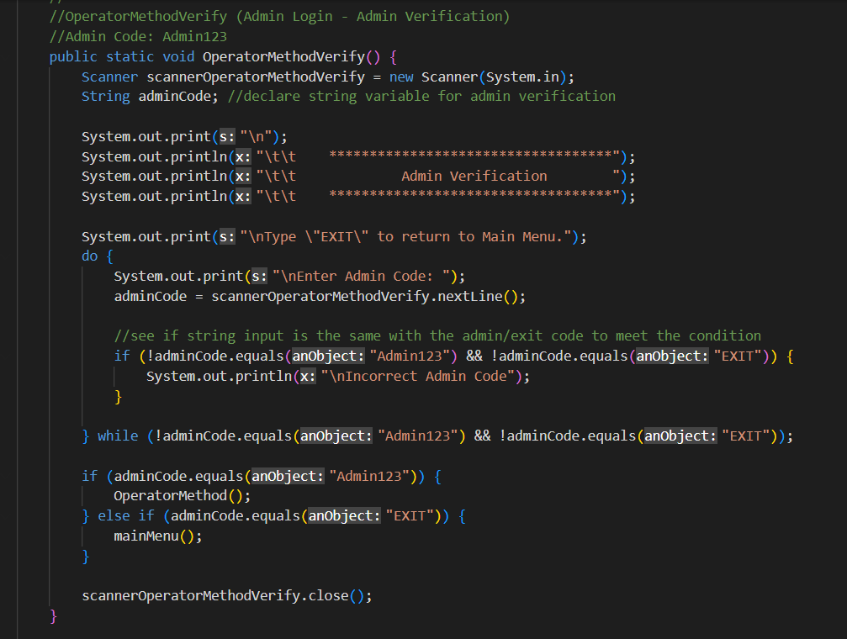
The Admin
Verification
Method

Slide 16
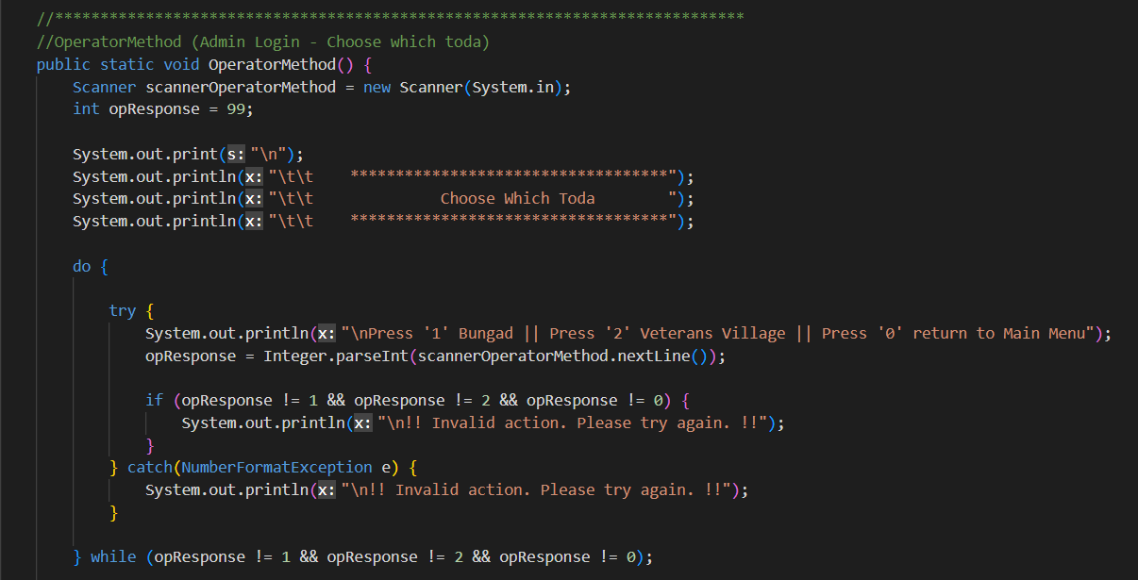
Admin - Choose Which Toda Method (1/2)

Slide 17
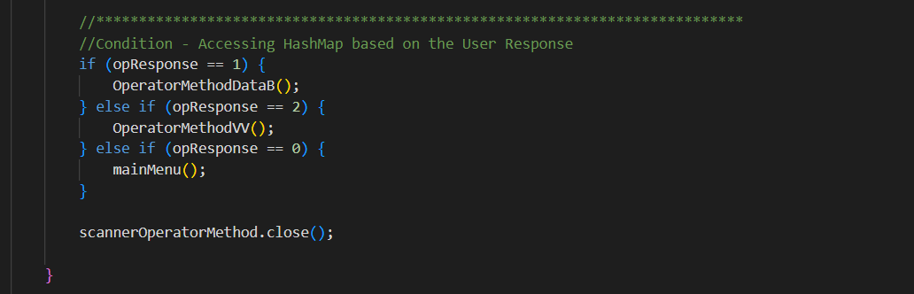
Admin - Choose Which Toda Method (2/2)

Slide 18
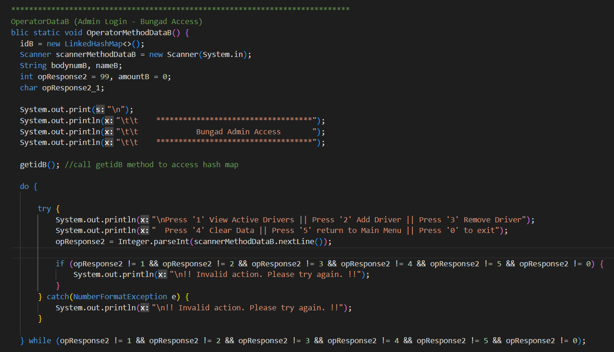
The Admin
Access Method (1/6)

Slide 19
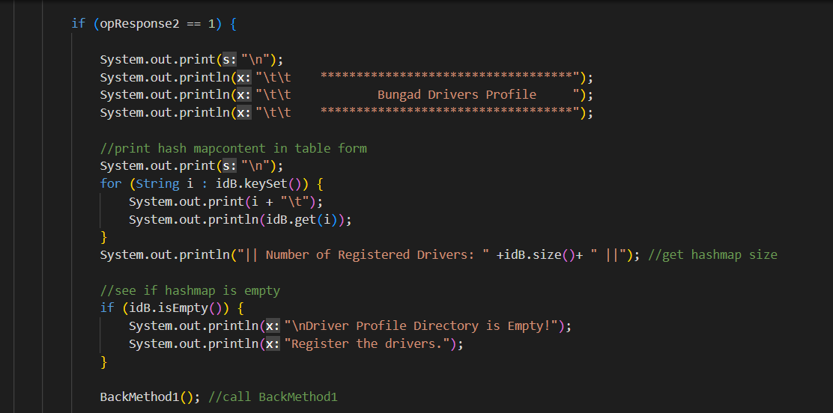
The Admin Access Method (2/6)

Slide 20
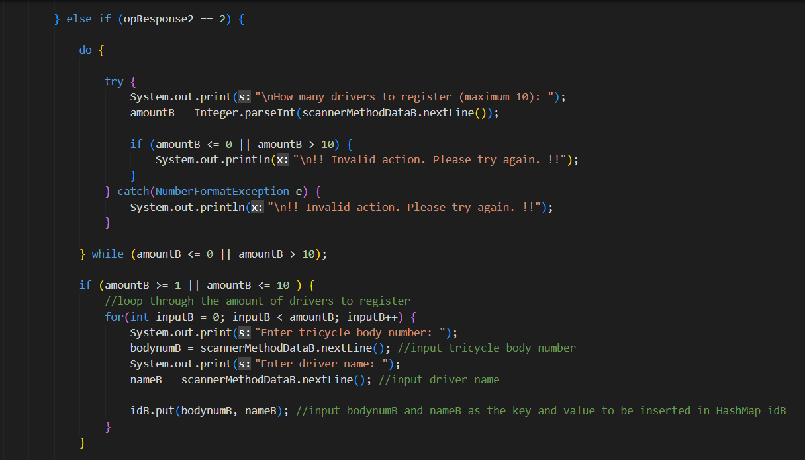
The Admin Access Method (3/6)

Slide 21
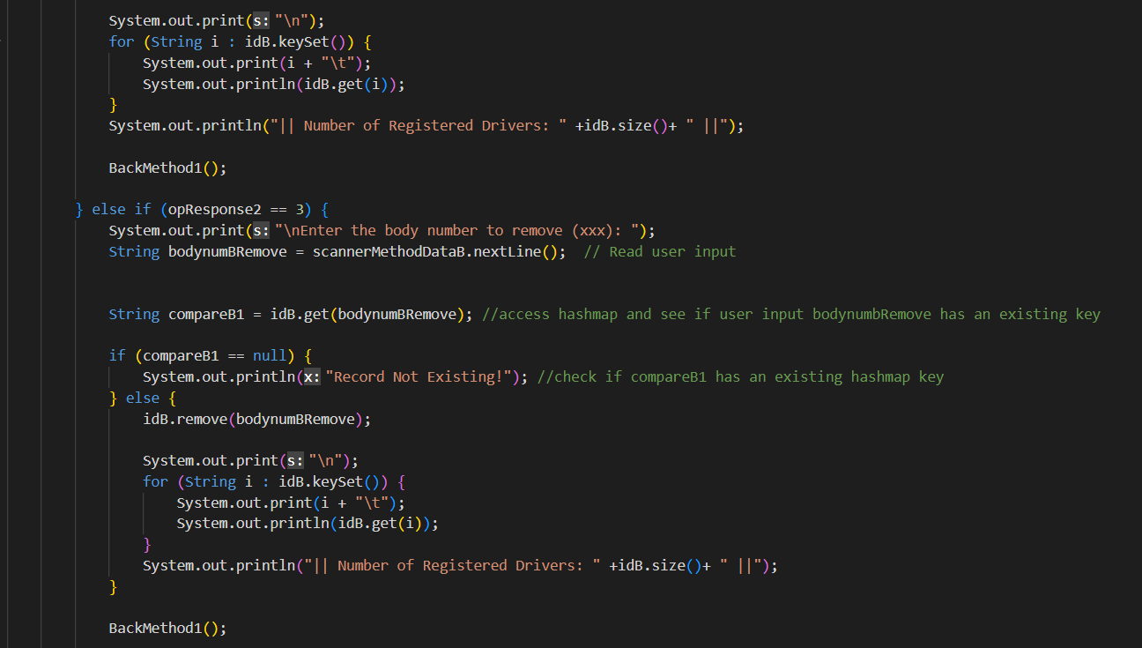
The Admin Access Method (4/6)

Slide 22
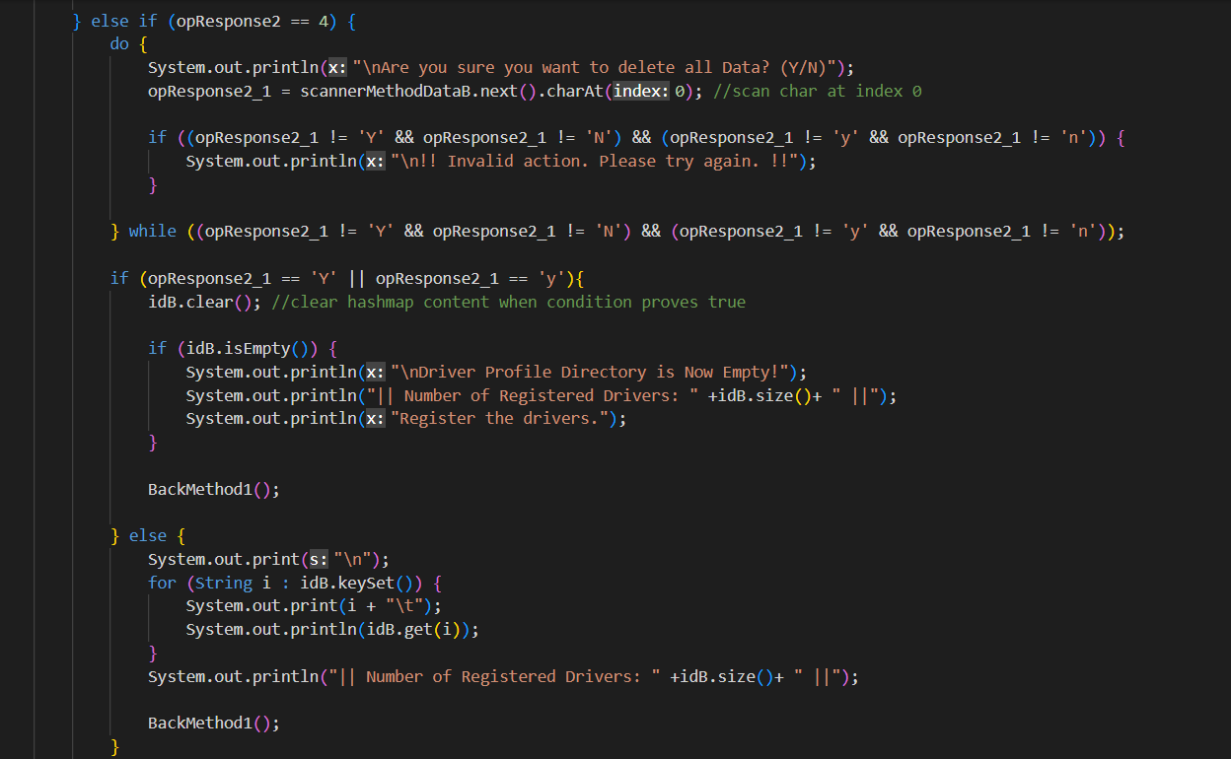
The Admin Access Method (5/6)

Slide 23
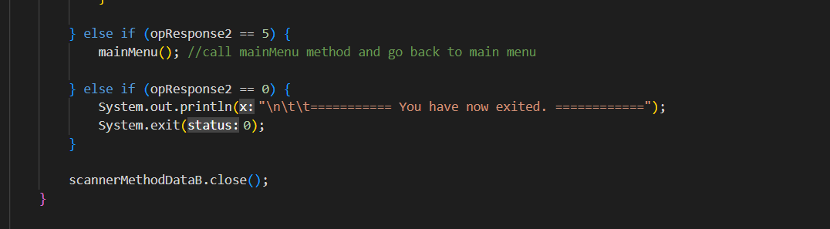
The Admin Access Method (6/6)

Slide 24
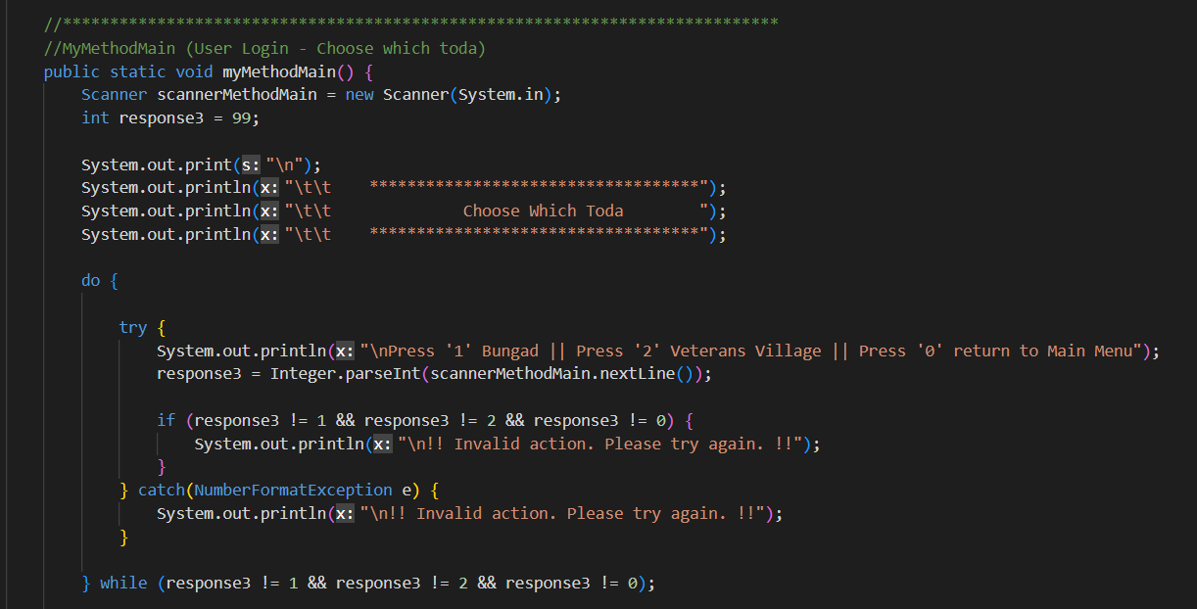
User - Choose Which Toda Method (1/2)

Slide 25
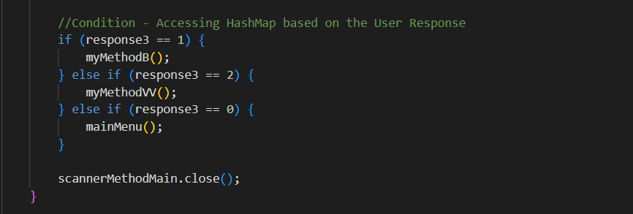
User - Choose Which Toda Method (2/2)

Slide 26
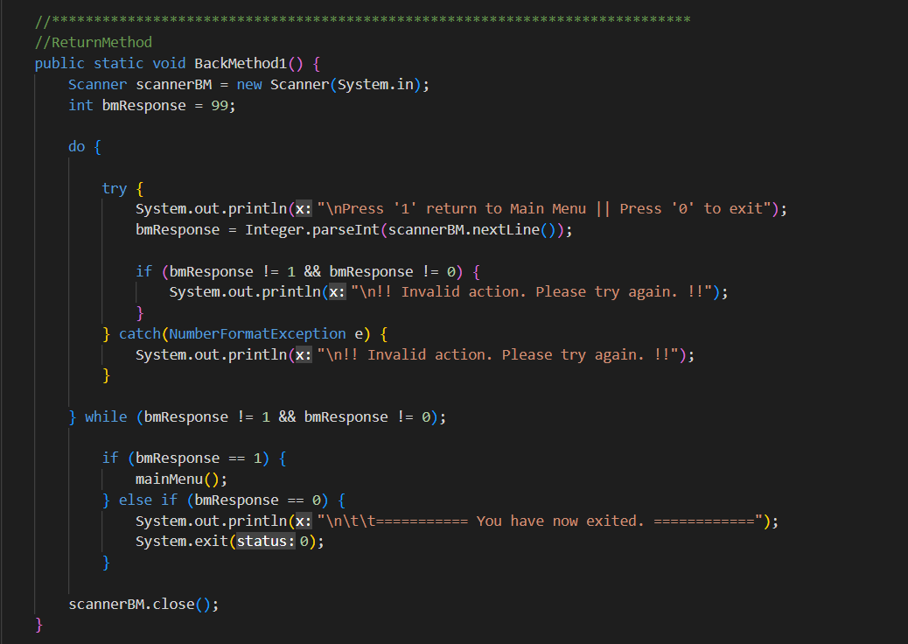
The Return Method

Slide 27
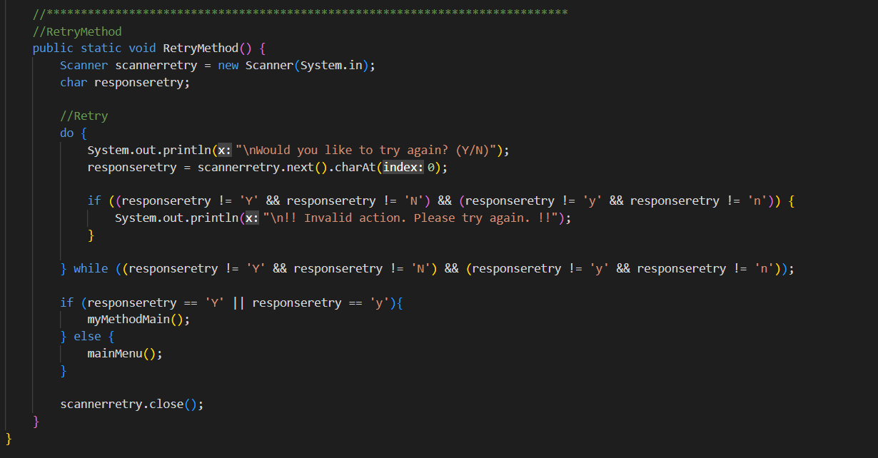
The Retry Method

Slide 28
References
Espina, M. P. (2022, October 5). Motorcycle driver dies after being hit by tricycle. Digicast Negros. https://digicastnegros.com/motorcycle-driver-dies-after-being-hit-by-tricycle/
GeeksforGeeks. (2022, January 23). Differences between HashMap and HashTable in Java. https://www.geeksforgeeks.org/differences-between-hashmap-and-hashtable-in-java/
Martin, B. (2015, October 2). The Tricycles are charging me double! Live in the Philippines. https://liveinthephilippines.com/the-tricycles-are-charging-me-double/
Medina, J. (2021, March 24). Tricycle driver, nagkunwaring patay matapos banggain ang isang motorsiklo para makaiwas sa kaso. Kami. https://kami.com.ph/127612-viral-video-of-tricycle-driver-pretending-to-be-dead-after-hitting-motorcycle.html
Nelz, J. (2022, March 10). Tricycle Driver Accidentally Side Swept Poor Cyclist (Video). Philippine Newspaper. https://newspapers.ph/2022/03/tricycle-driver-accidentally-side-swept-poor-cyclist-video/
Poe, G. (n.d.). An Act Providing for a Magna Carta for Tricycle Drivers and Operators, Institutionalizing Mechanisms for Its Implementation and for Other Purposes. In Senate of the Philippines. Seventeenth Congress of the Republic of the Philippines Second Regular Session, Taguig City, Metro Manila, Philippines. http://legacy.senate.gov.ph/lisdata/2762323886!.pdf
Statista. (2022, February 7). Number registered private motorcycles and tricycles Philippines 2012-2021. https://www.statista.com/statistics/708054/number-of-registered-private-motorcycles-and-tricycles-in-the-philippines/
What are the differences between a HashMap and a Hashtable in Java? (2008, September 2). Stack Overflow. https://stackoverflow.com/questions/40471/what-are-the-differences-between-a-hashmap-and-a-hashtable-in-java

